Slide 1
Guilford County Financial
Greg Purvine (gnpurvin)
Shiyang Xiao (MrVinegar)
Evan Crabtree (Crabtr)
Rohit Gulia (rohit-gulia)
Cody Cothern (Mask487)

Slide 2
Project Overview
What is our dataset?
❖Financial Data including adopted budget data (2013-2018) and historical transaction data (2006-2017) for Guilford County.
What is our idea?
❖Develop models of the data that can detect anomalous values and predict future values.
What purpose does that serve?
❖To help the Financial and Budget Department of Guilford County maintain their expected spending and transactions.

Slide 3
Tasks
Data Dictionary and Documentation - Greg, Vincent
Finding any patterns/relationships in the Data - Vincent, Rohit
Basic Data Statistics - Evan, Rohit, Cody
Anomaly Detection - Cody, Greg
Future Budget Prediction - Rohit, Evan, Vincent

Slide 4
Data Description

Slide 5
Data Description
Budgets
Departments have sub-departments
Sub-departments perform related services
Services either generate or cost money
Account represents specific revenue/expense source
Money paid into/from Funds

Slide 6
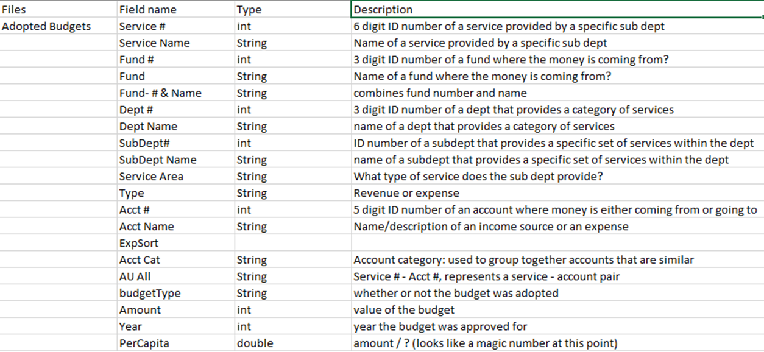
Budget Data Dictionary

Slide 7
Data Description
Transaction
Occurs between an Entity and an Account
Entity - fund & service number relationship
Date
Description
Amount

Slide 8
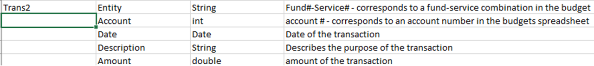
Transaction Data Dictionary

Slide 9
Data Cleaning
Budget Data
Missing values
Service didn’t exist that year
Remove redundancies
Fund #s ≥ 400
Split Data
Expenses & Revenue

Slide 10
Basic Data Statistics

Slide 11
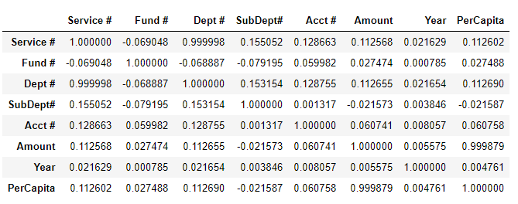
Budget Correlation Table
Service & Department
Service always associated with same department
Per Capita & Amount
Per Capita = Amount ÷ Population

Slide 12
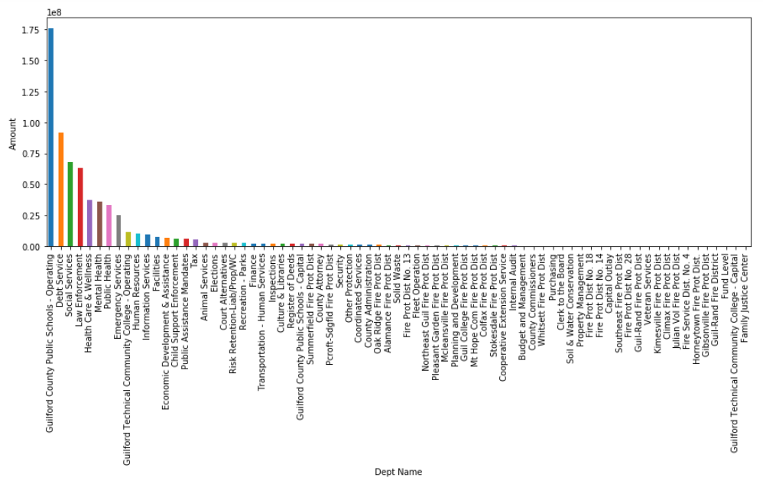
Expenses By Department (2013)

Slide 13
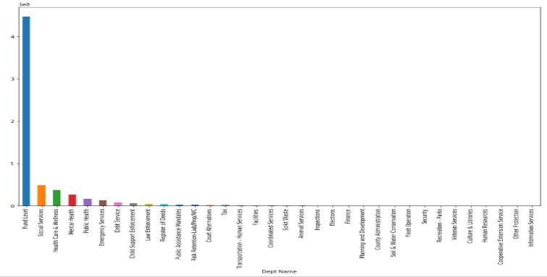
Revenue By Department (2013)

Slide 14
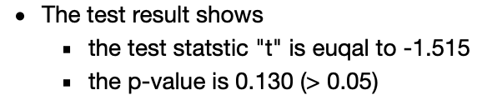
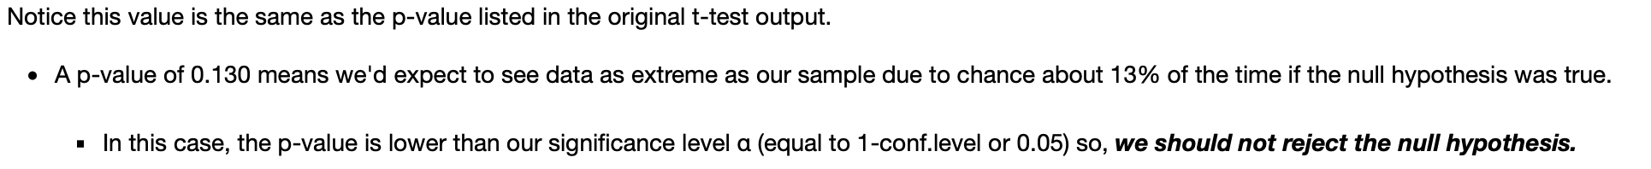
Null Hypothesis
One-Sample T-Test
whether the average money spent in 2013 differs from the population:
Null Hypethoesis H0 - 'Total Expenses in 2013 is similar to all expenses'
Alternative Hypothesis H1 - 'Total Expenses in 2013 is different to all expenses'

Slide 15
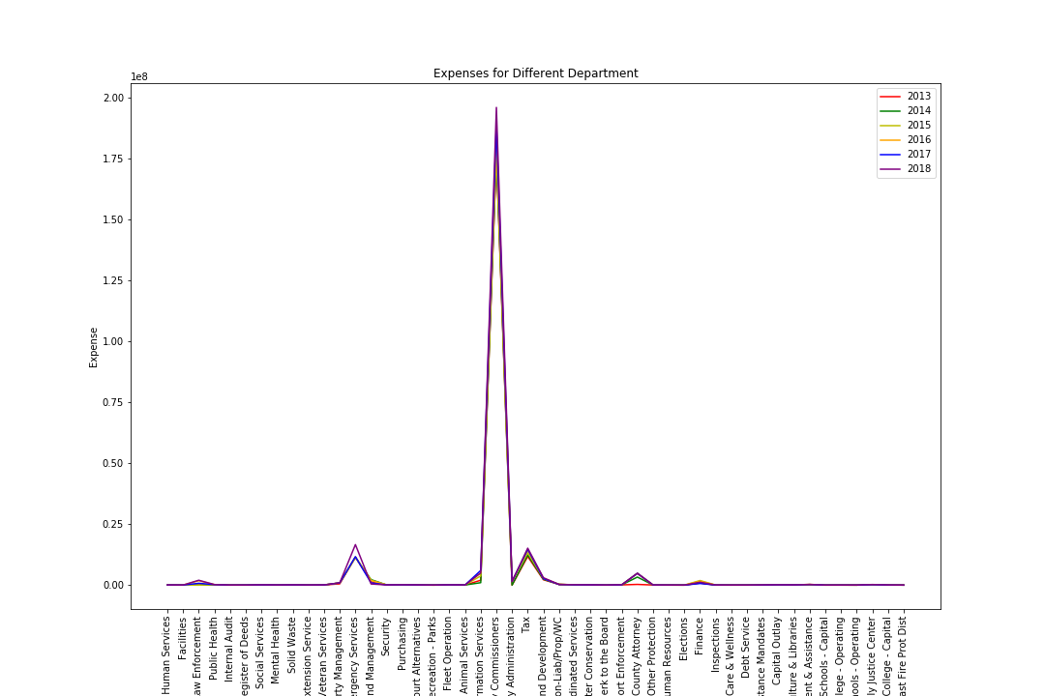
Expenses for Different Department

Slide 16
Patterns

Slide 17
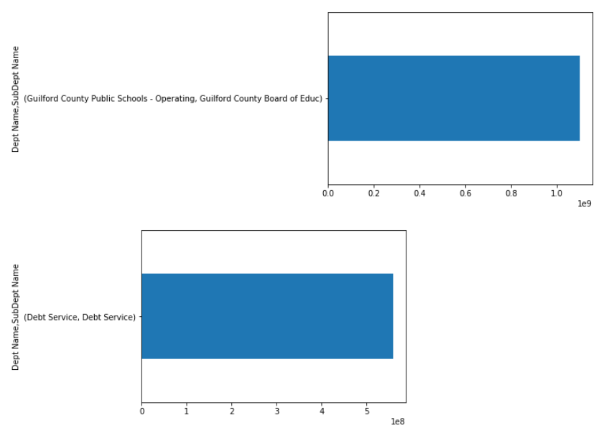
Top spending Departments and their Sub-departments
Notes:
GCS and debt services only have one sub-department

Slide 18
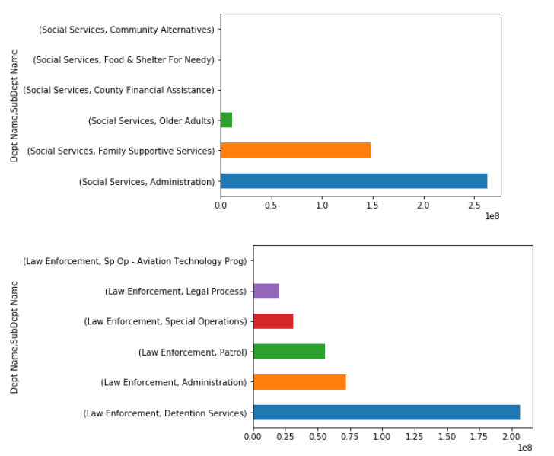
Top spending Departments and their Sub-departments

Slide 19
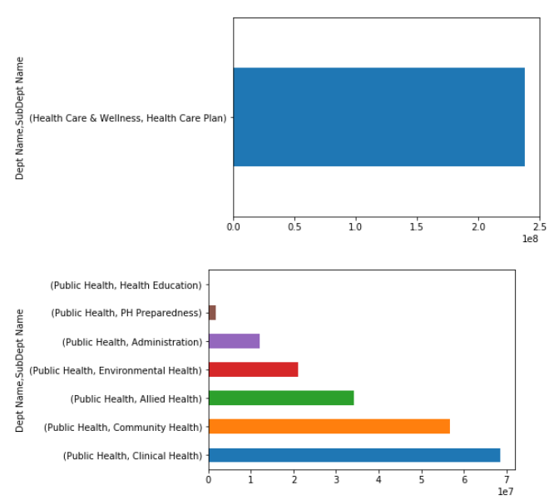
Top spending Departments and their Sub-departments

Slide 20
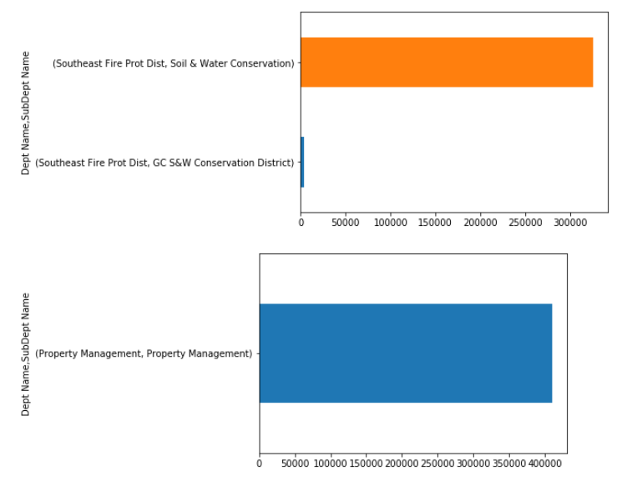
Least spending Departments and their Sub-departments

Slide 21
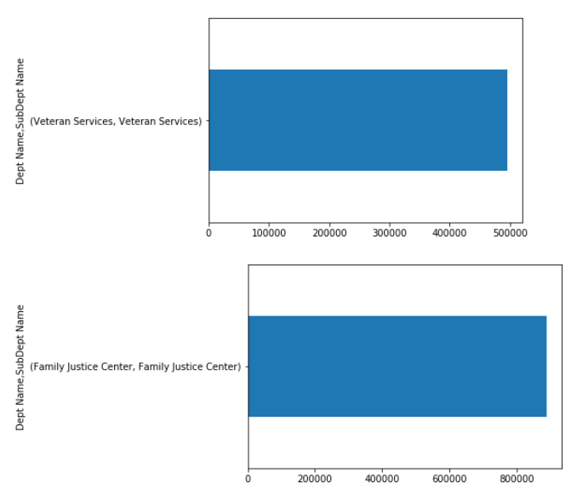
Least spending Departments and their Sub-departments

Slide 22
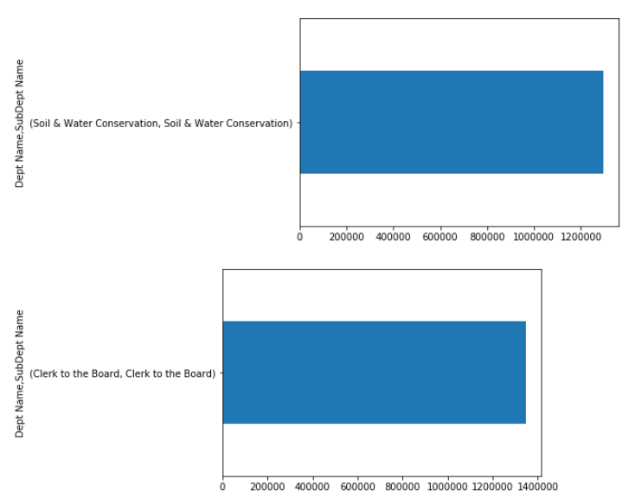
Least spending Departments and their Sub-departments

Slide 23
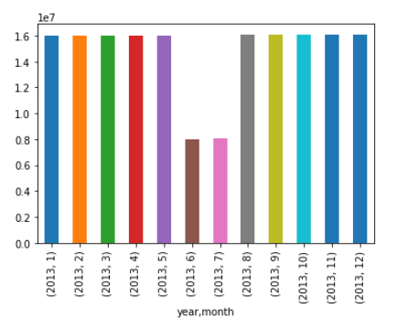
Expenses by month by Guilford County Public Schools

Slide 24
Anomaly Detection

Slide 25
Anomaly Detection Methodology
Sigma 3
Easy Implementation
Simple Definition of Anomaly
Anomaly - Value is ≥ 3 standard deviations above or below the mean
IQR
Easy to Implement
Anomalies Defined as:
Below Q1 - 3 * IQR
Above Q3 + 3 * IQR
Considered “extreme anomalies”
Trying to account for changes in prices

Slide 26
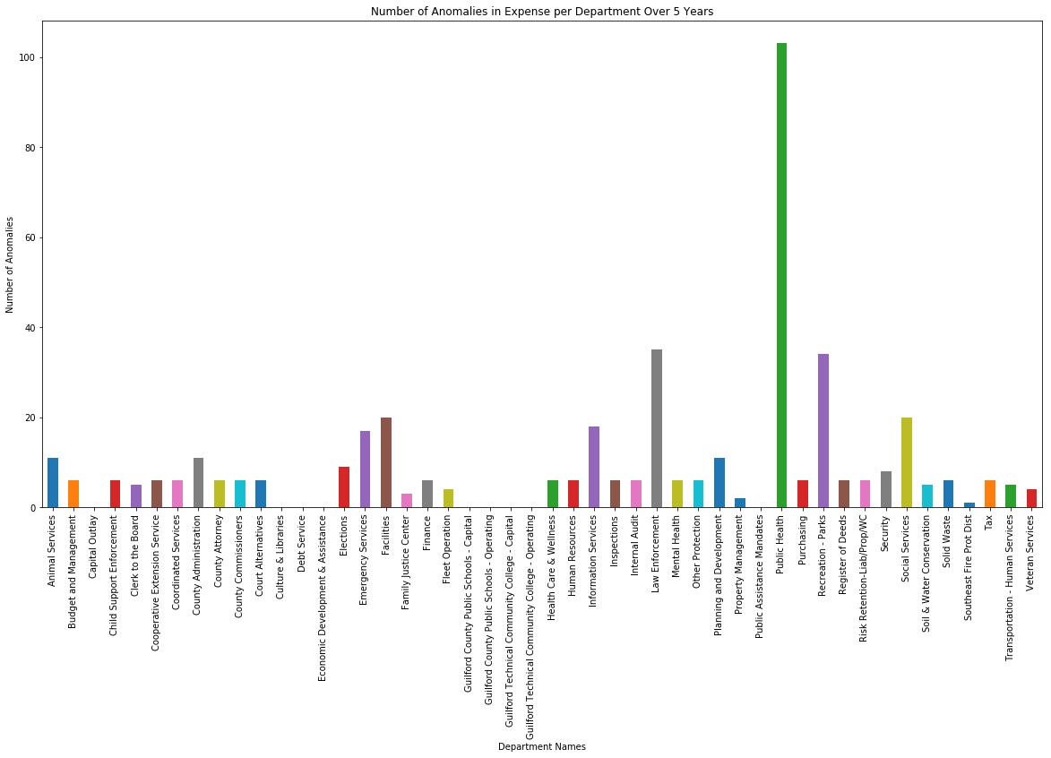
Expense Anomalies per Department (Sig 3)

Slide 27
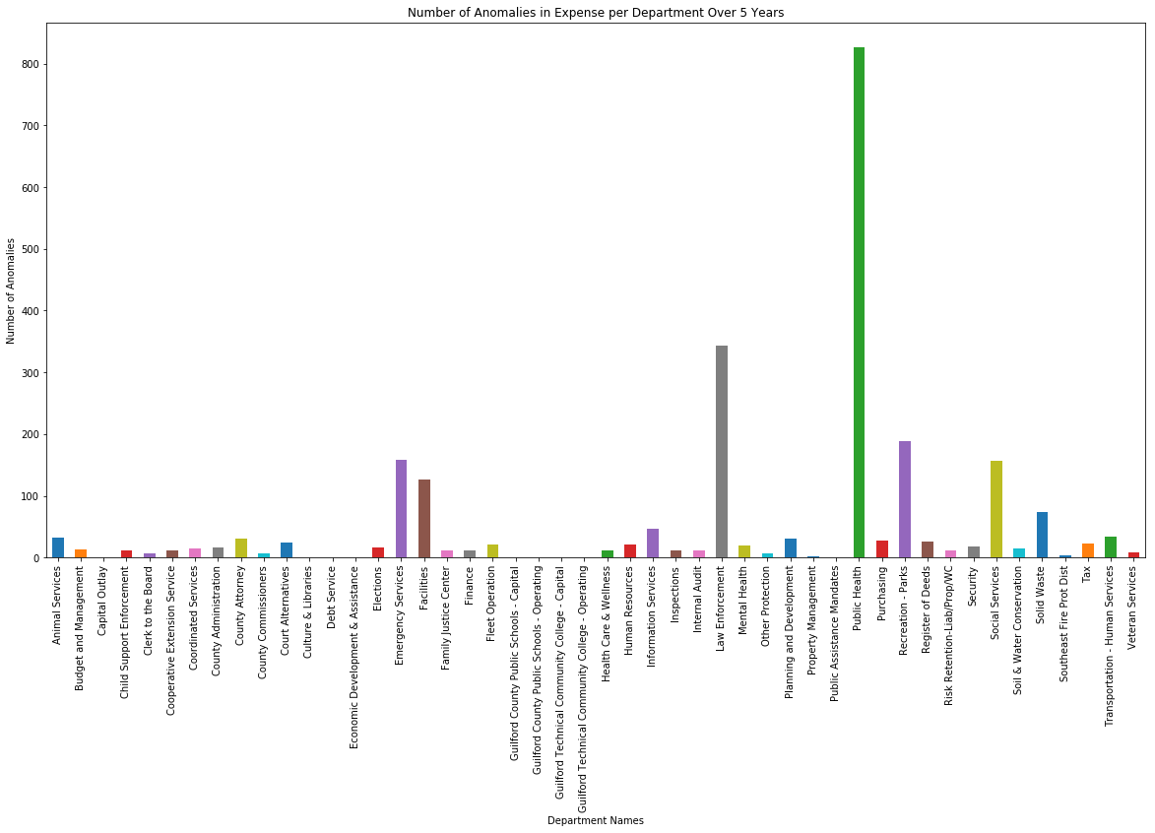
Expense Anomalies per Department (IQR)

Slide 28
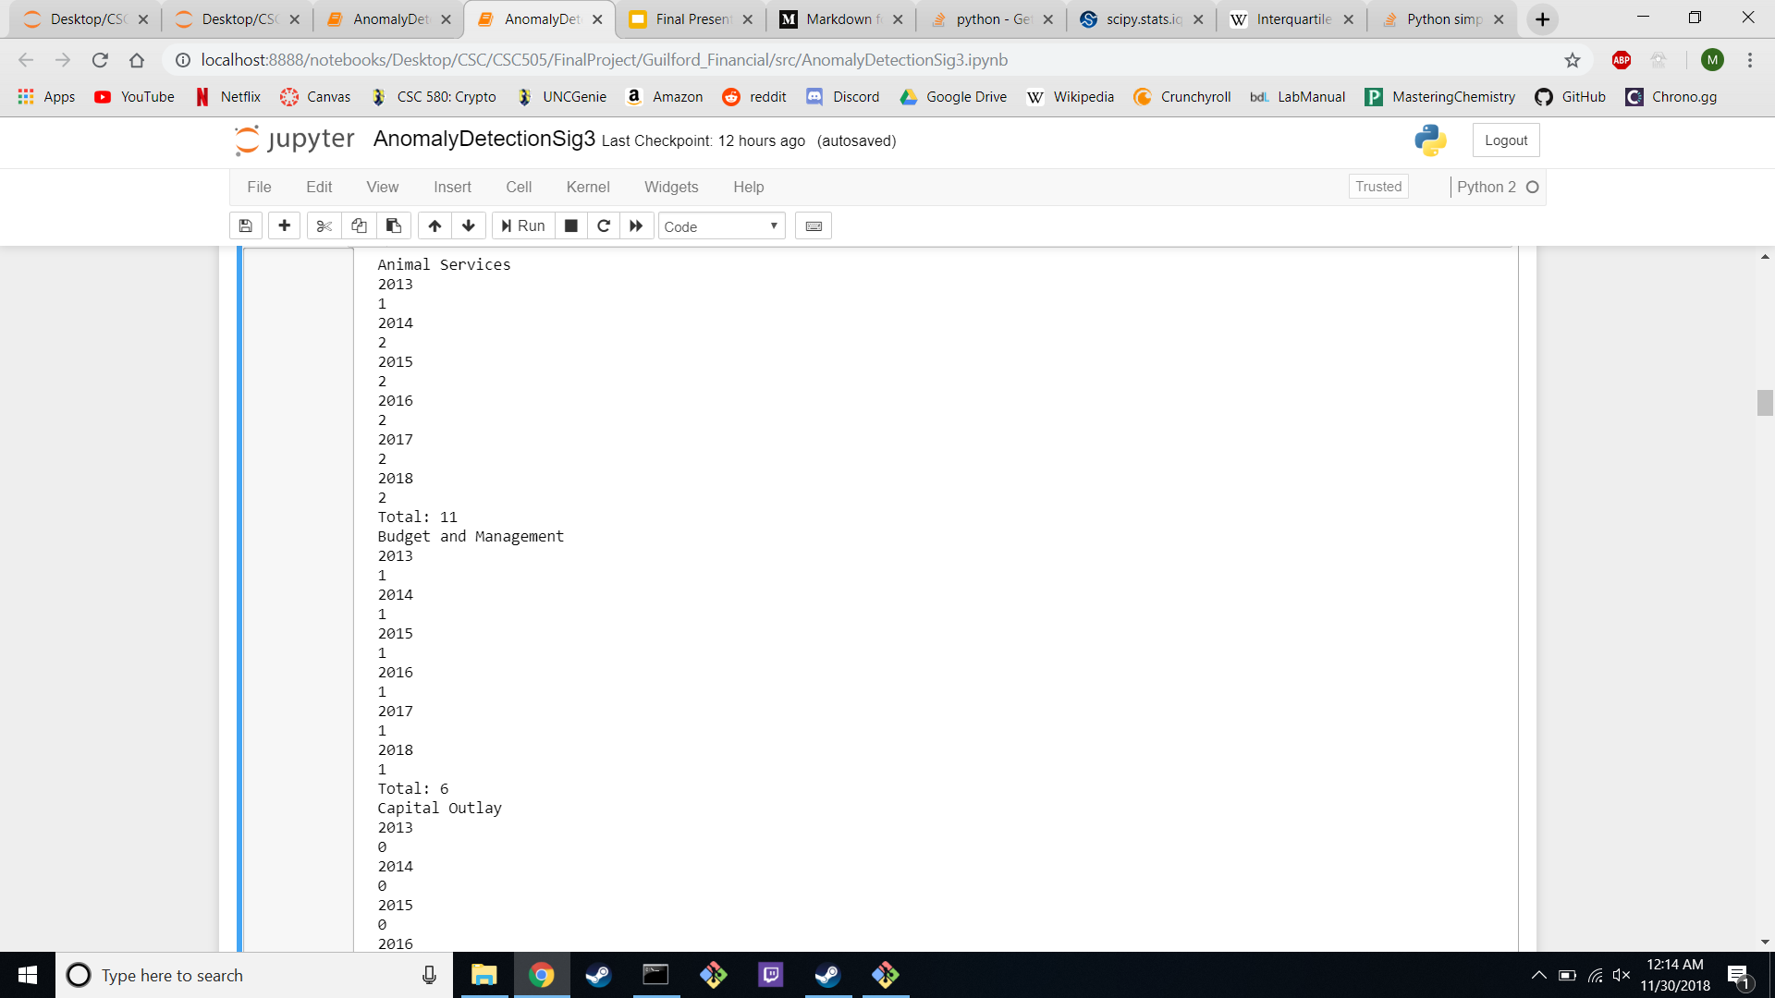
Expense Anomalies per Department per Year (Sig 3)

Slide 29
Expense Anomalies per Department per Year (IQR)

Slide 30
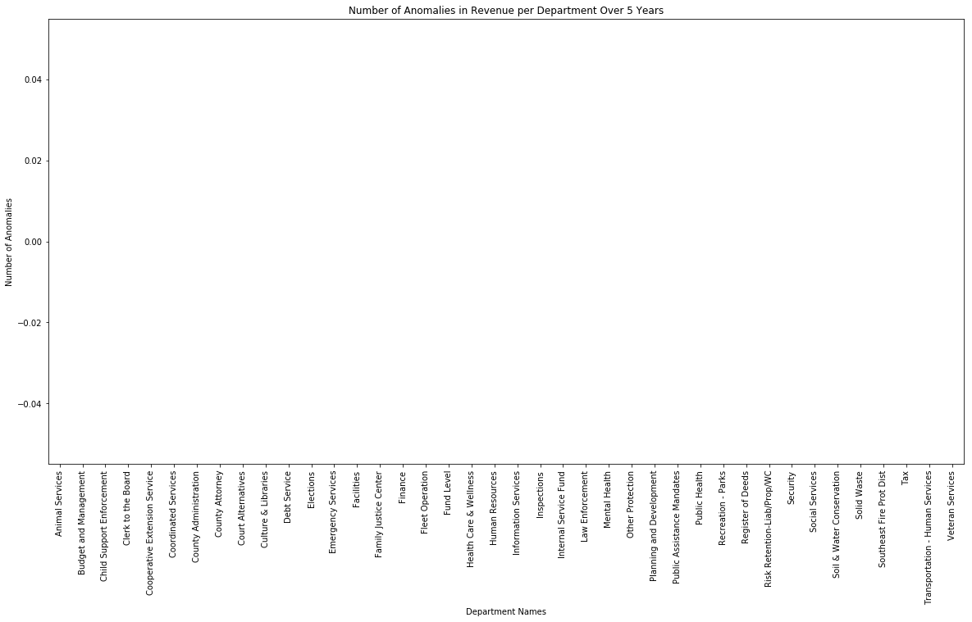
Revenue Anomalies per Department (Sig 3)

Slide 31
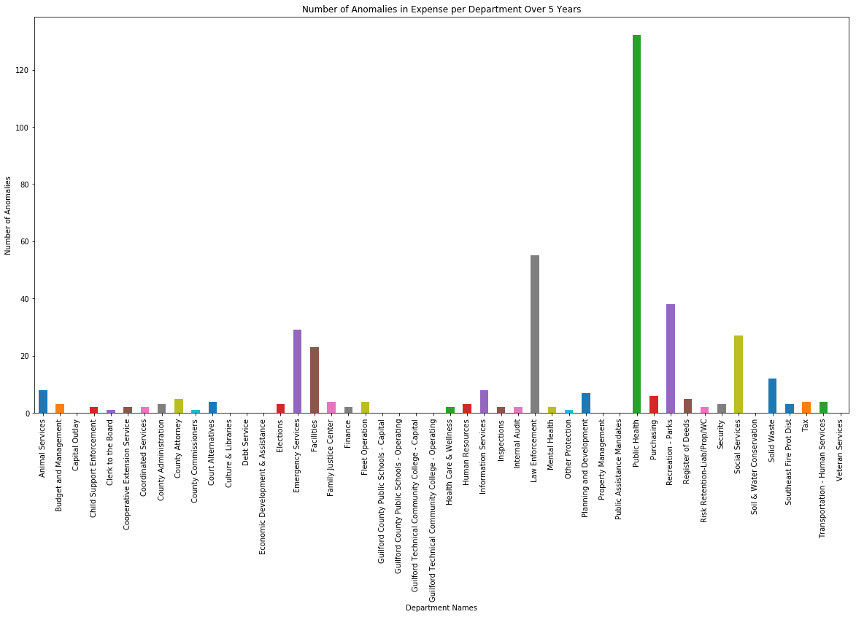
Revenue Anomalies per Department (IQR)

Slide 32

Revenue Anomalies per Department per Year (Sig 3)

Slide 33
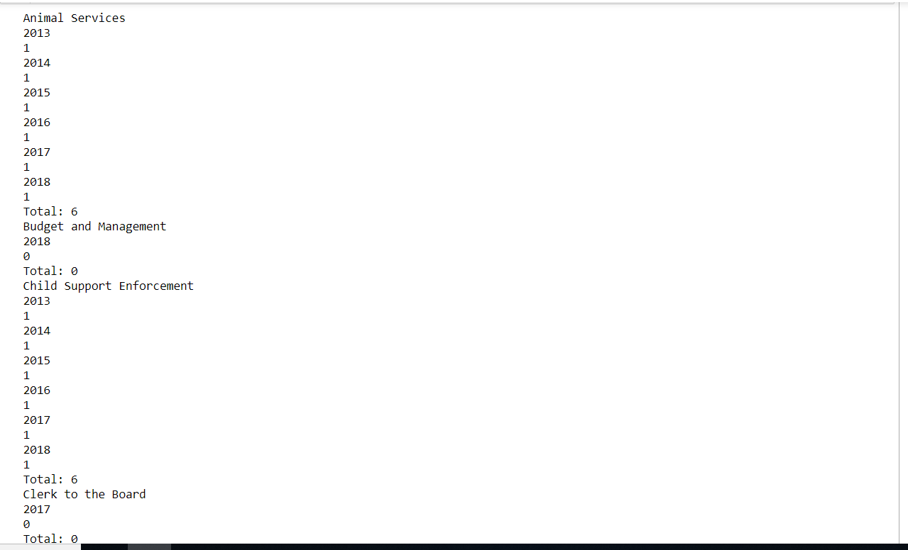
Revenue Anomalies per Department per Year (IQR)

Slide 34
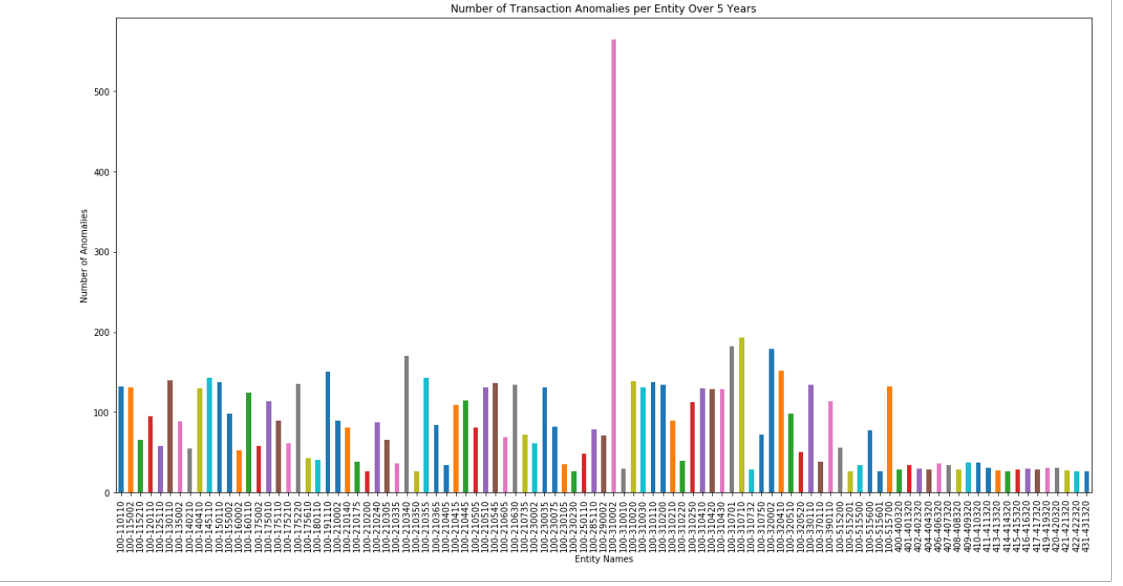
Transaction Anomalies (Sig 3)
Notes:
100-310002 Law Enf Administration
Anything with > 25 anomalies

Slide 35
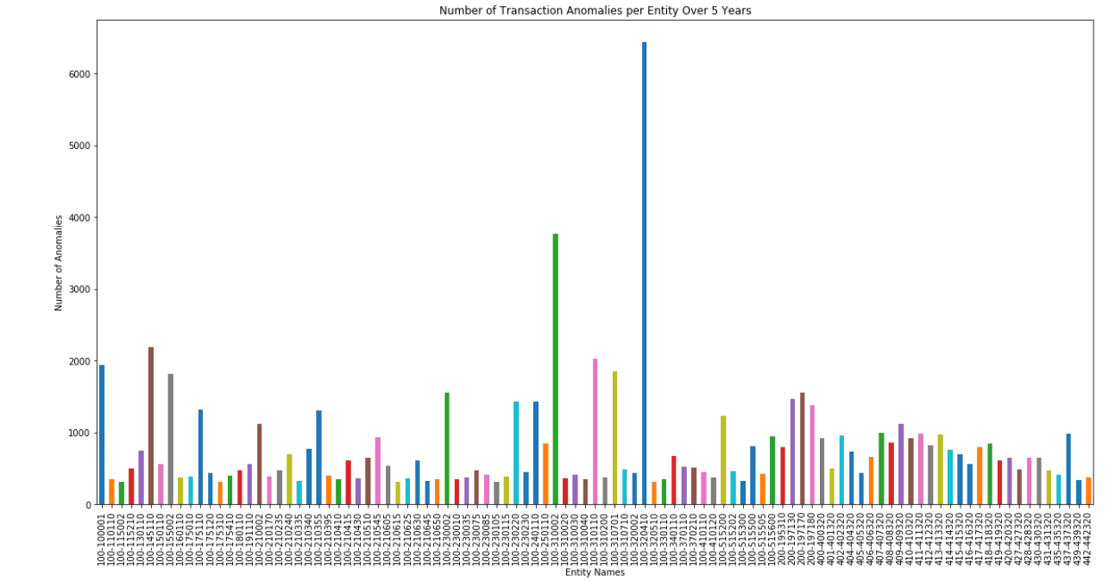
Transaction Anomalies (IQR)
Notes:
Anything with > 300 anomalies
100-320410 Medical-Emergency Med Services
100-310002 Law Enf Administration

Slide 36
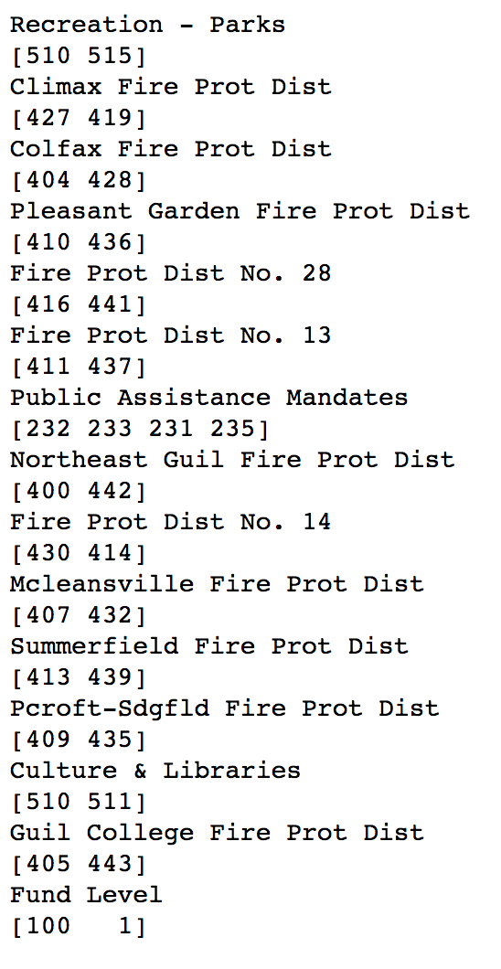
Anomalies in department
classifications

Slide 37
Budget Forecasting

Slide 38
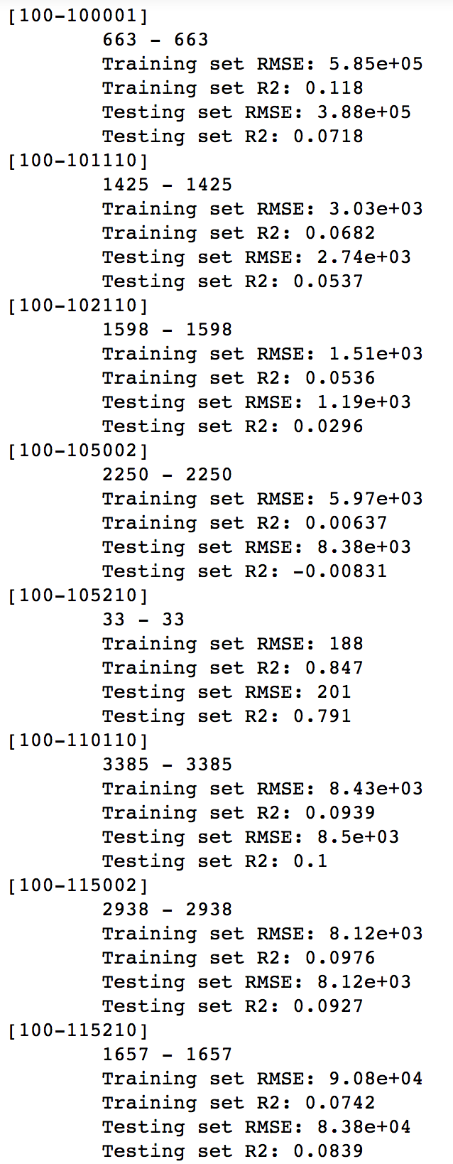
Linear regression model

Slide 39
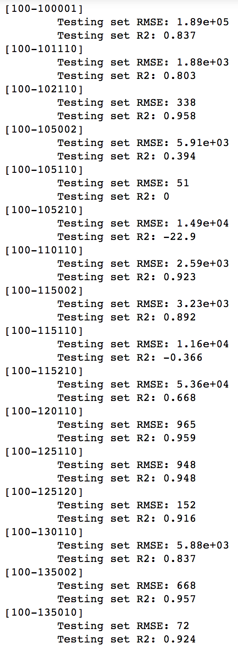
Random forest regression

Slide 40
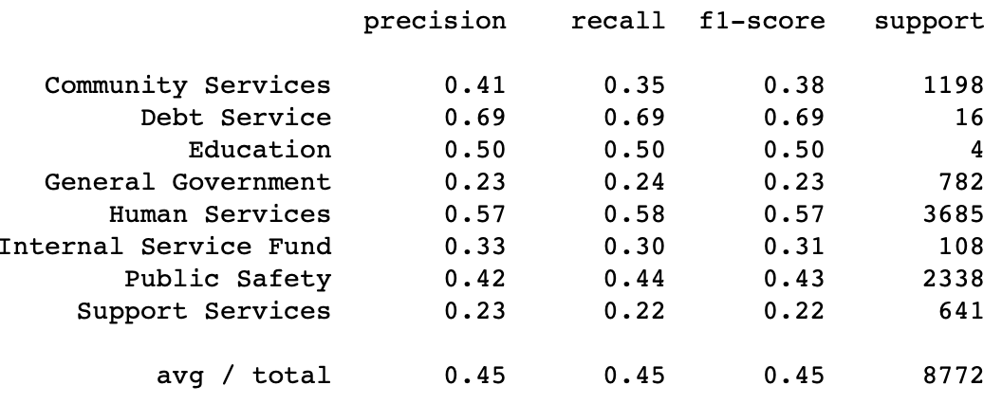
Machine Learning for Budget File

Slide 41
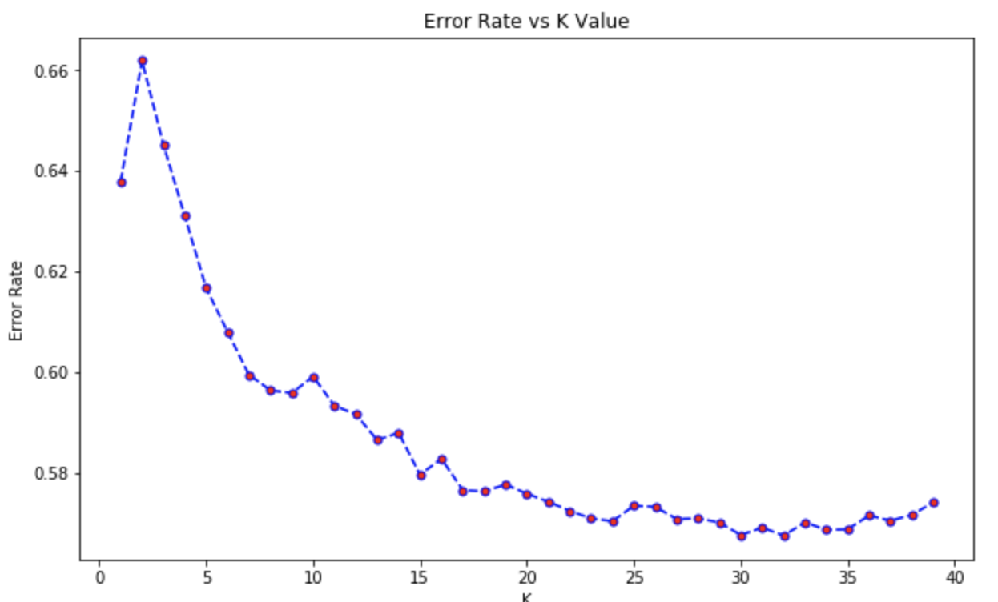
K-Nearest-Neighbor
Using K values from 1 - 40

Slide 42
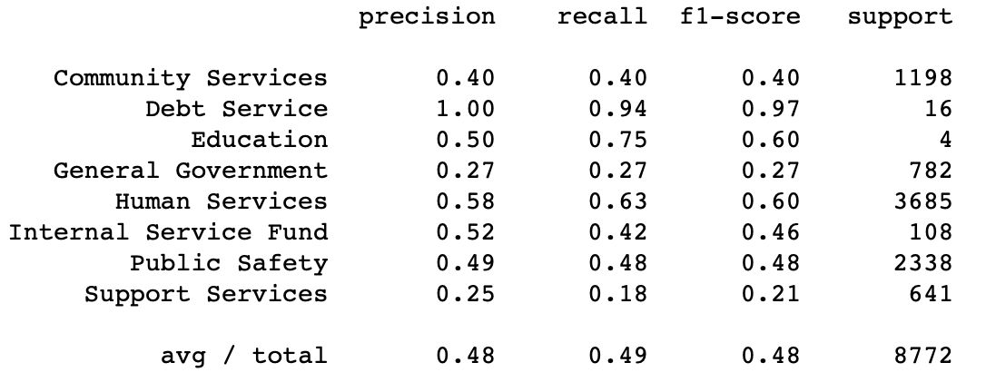
Machine Learning for Budget File

Slide 43
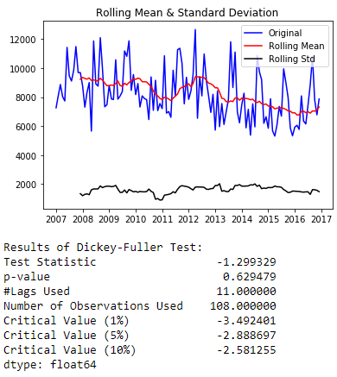
Stationarity Test for Time Series Data

Slide 44
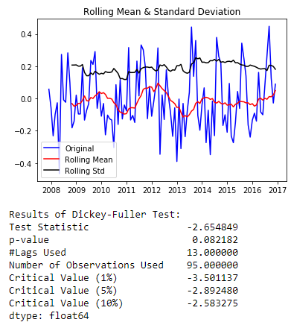
After Log Transformation and moving average for Stationary

Slide 45
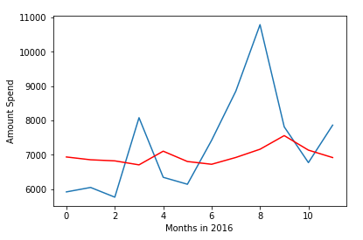
Time Series Prediction using ARIMA Model

Slide 46
Thank You For Listening!
Question?

